Slide 1
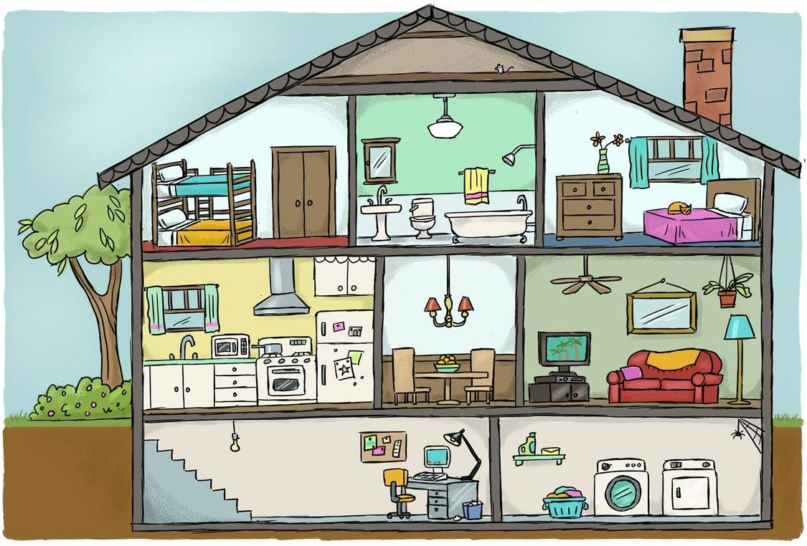
Rooms around the house

Slide 2
a room with a bath
bathroom

Slide 3
a room with a bed
bedroom

Slide 4
a room where we can have dinner
dine用餐
dinner / dining
sounds alike
dining room

Slide 5
a room where we can live
living room

Slide 6
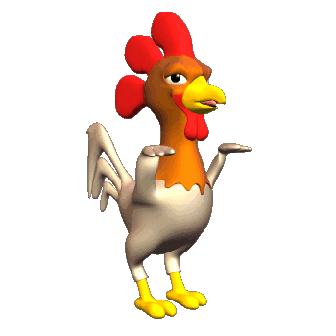
a room where we can cook
chicken
kitchen

Slide 7
a place where we play and plant
yard

Slide 8
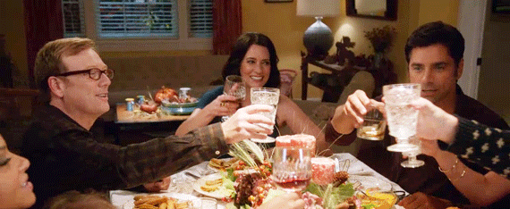
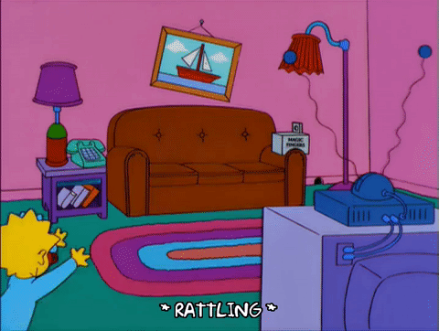
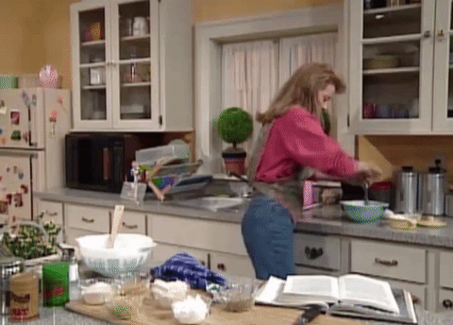
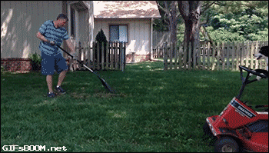
1
2
3
bathroom
bedroom
dining room
4
5
6
living room
kitchen
yard

Slide 9
Parts of the House

Slide 10
We can learn more!

Slide 11
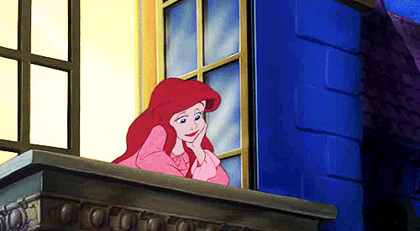
balcony

Slide 12
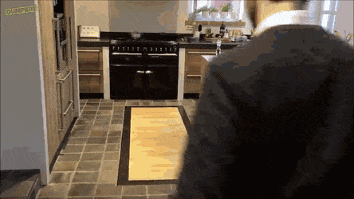
basement

Slide 13
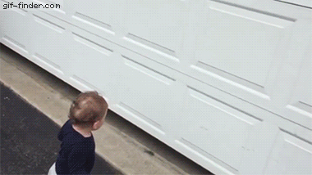
garage

Slide 14
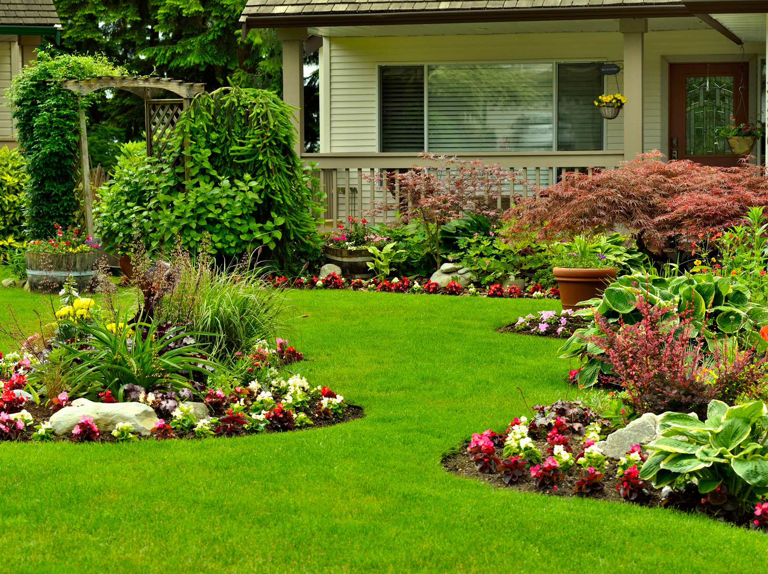
garden

Slide 15
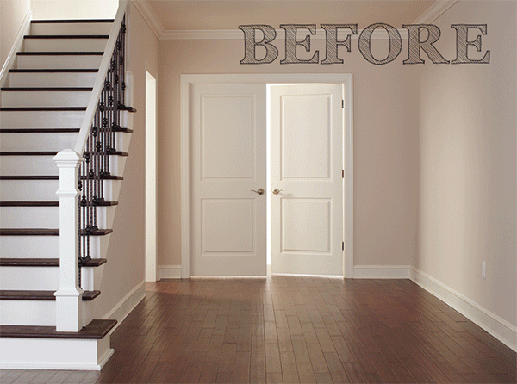
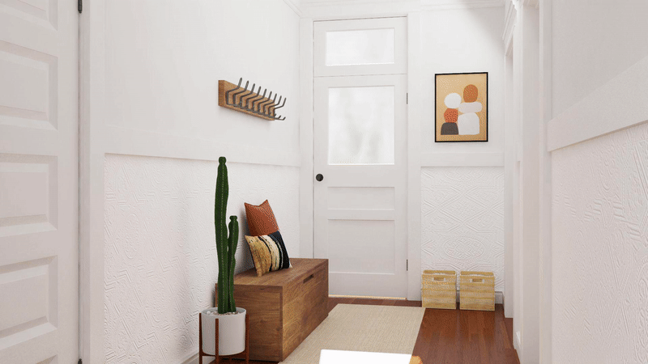
entryway

Slide 16
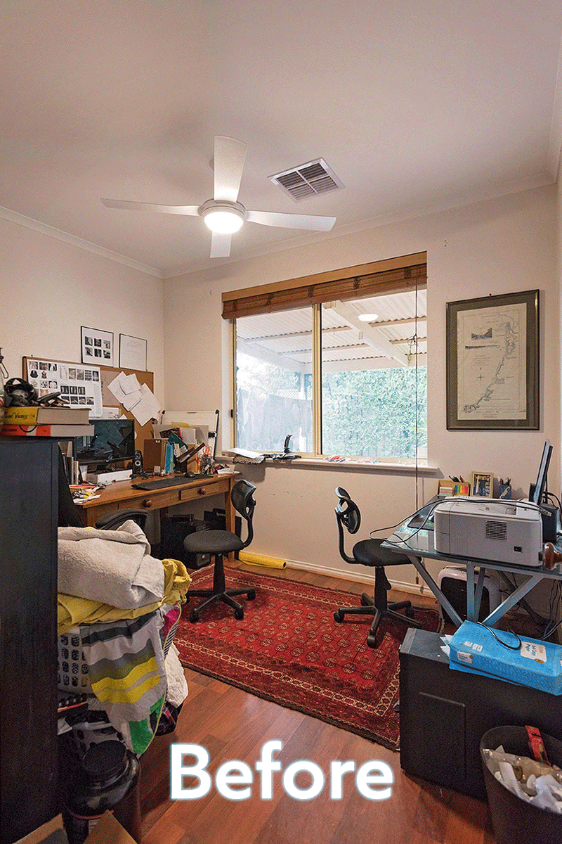
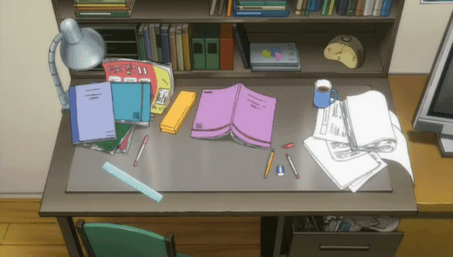
study

Slide 17
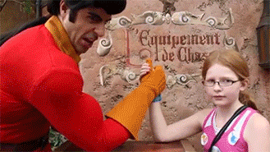
Challenge Time!!!!!

Slide 18
Q1. Where in the house do you brush your teeth?
in the bathroom

Slide 19
Q2. Where in the house do you cook food?
in the kitchen

Slide 20
Q3. Where in the house do you sleep at night?
in the bedroom

Slide 21
Q4. Where in the house do you eat dinner?
in the dining room

Slide 22
Q5. Where in the house do you sit with your family and watch TV?
in the living room

Slide 23
Q6. Where do you see grass?
in the yard

Slide 24
Q7. Where are your books, toys and games?
in the bedroom

Slide 25
Q8. Where are the dishes washed?
in the kitchen

Slide 26
Q9. Where can you plant the flowers?
in the yard

Slide 27
Q10. Where does your family relax together?
in the living room

Slide 28
Q11. Where can you get wet inside your house?
in the bathroom

Slide 29
Q12. Where is the largest table for eating?
in the dining room

Slide 30
Emoji
Guessing Game

Slide 31
PLACES:
1. Where are you?
ilorgnomvi
Answer: living room
2. Where are you?
moorhtab
Answer: bathroom

Slide 32
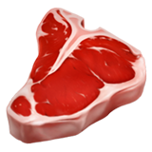
PLACES:
3. Where are you?
tenhick
Answer: kitchen
4. Where are you?
grindmooni
Answer: dining room

Slide 33
PLACES:
5. Where are you?
broomed
Answer: bedroom
6. Where are you?
dary
Answer: yard

Slide 34
Warm-up:
1. Who is he?
Answer: 陳時中
2. What subject is it?
Answer: PE

Slide 35
Warm-up:
3. What movie is it?
Answer: Toy Story
4. Where are you from?
Answer: Taiwan

Slide 36
Homework this week
聽: CD2第2-6首。
說&讀:聽CD時跟著大聲唸。
完成請家長在課本P43簽名，可換印章。
寫:英語練習簿Unit 3單字
鼓勵創作emoji猜謎題目
Mandy老師網頁有放新的Quizlet連結，可上去挑戰Unit 3的單字喔!

